Slide 1
Energy and Momentum Methods

Slide 2
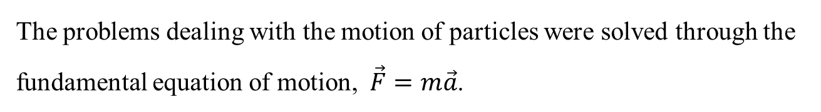
Introduction
The problems dealing with the motion of particles were solved through the fundamental equation of motion, $\vec{F}=m\vec{a}$.
Method of work and energy: directly relates force, mass, velocity and displacement.
Method of impulse and momentum: directly relates force, mass, velocity, and time.

Slide 3
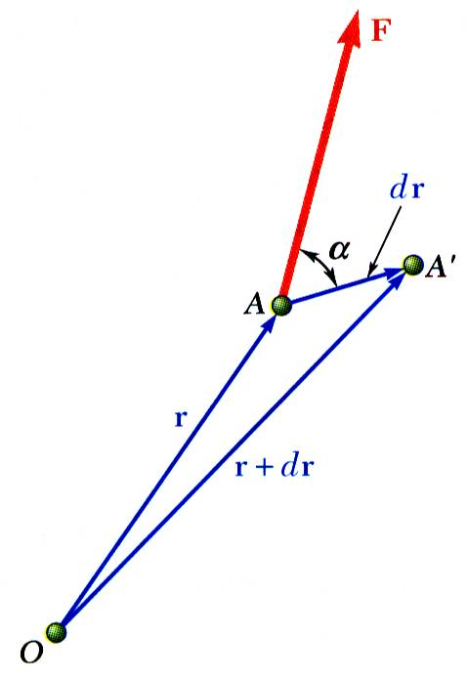


Work of a Force
$$\overline{F}=F_{x}i+F_{y}j+F_{z}k$$
$$dr=dxi+dyj+dzk$$
Differential vector is the particle displacement.
Work of the force is
Work is a scalar quantity, i.e., it has magnitude and sign but not direction.
Dimensions of work are Units are

Slide 4
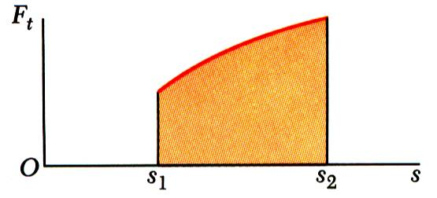
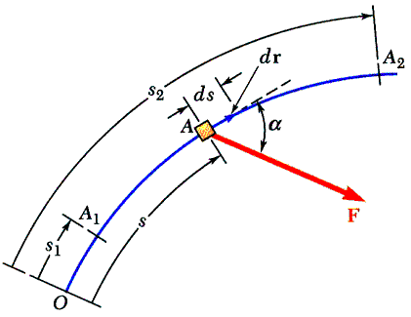
Work of a Force
Work of a force during a finite displacement,
Work is represented by the area under the curve of F_{t} plotted against s.

Slide 5
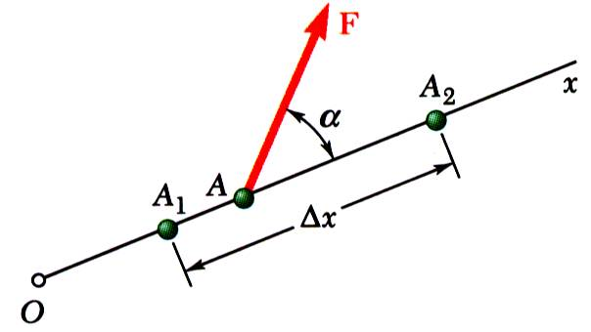
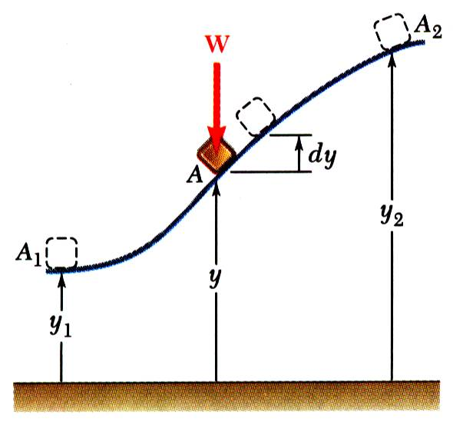
Work of a Force
Work of a constant force in rectilinear motion,
Work of the force of gravity,
Work of the weight is equal to product of weight W and vertical displacement dy.
Work of the weight is positive when Δy < 0, i.e., when the weight moves down.

Slide 6
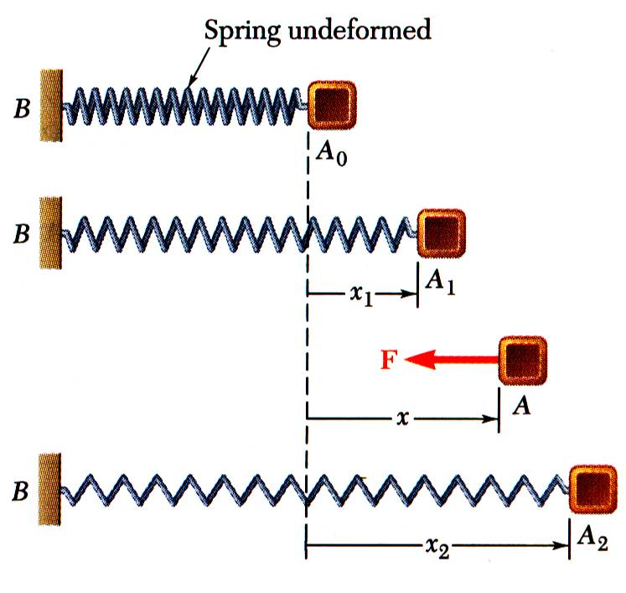
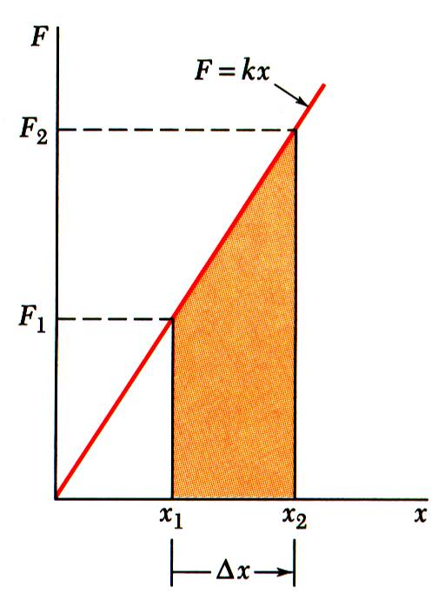
Work of a Force
Magnitude of the force exerted by a spring is proportional to deflection,
Work of the force exerted by spring,
Work of the force exerted by spring is positive when x₂ < x₁, i.e., when the spring is returning to its undeformed position.
Work of the force exerted by the spring is equal to negative of area under curve of F plotted against x,

Slide 7
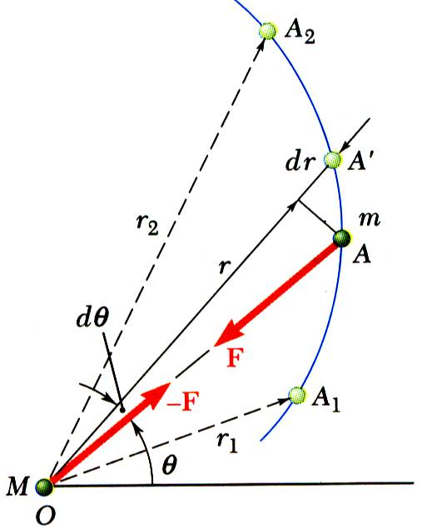
Work of a Force
Work of a gravitational force (assume particle M occupies fixed position O while particle m follows path shown),

Slide 8
Work of a Force
Forces which do not do work (ds = 0 or cos α = 0):
reaction at frictionless pin supporting rotating body,
reaction at frictionless surface when body in contact moves along surface,
reaction at a roller moving along its track, and
weight of a body when its center of gravity moves horizontally.

Slide 9
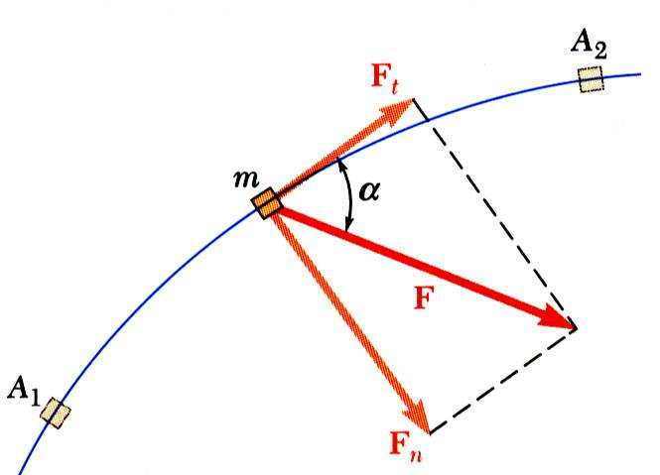
Particle Kinetic Energy: Principle of Work & Energy
Consider a particle of mass m acted upon by force
Integrating from A₁ to A₂ ,
The work of the force is equal to the change in kinetic energy of the particle.
Units of work and kinetic energy are the same:

Slide 10
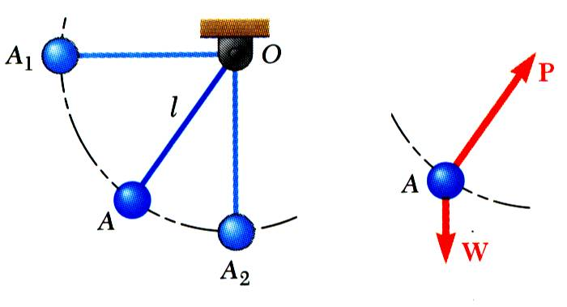
Applications of the Principle of Work and Energy
Wish to determine velocity of pendulum bob at A₂. Consider work & kinetic energy.
Force acts normal to path and does no work.
Velocity found without determining expression for acceleration and integrating.
All quantities are scalars and can be added directly.
Forces which do no work are eliminated from the problem.

Slide 11
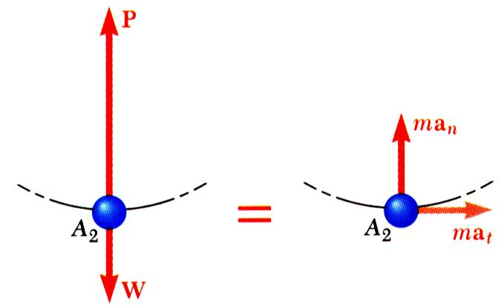

Applications of the Principle of Work and Energy
Principle of work and energy cannot be applied to directly determine the acceleration of the pendulum bob.
Calculating the tension in the cord requires supplementing the method of work and energy with an application of Newton’s second law.
As the bob passes through A₂ ,
$$a_{n}=\frac{v^{2}}{r}$$

Slide 12
Power and Efficiency
rate at which work is done.
Dimensions of power are work/time or force*velocity. Units for power are

Slide 13
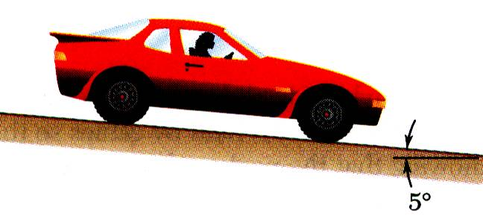

$$T_{1}=\frac{1}{2}mv^{2}=\frac{1}{2}\frac{4000}{9.81}∗{(\frac{60000}{3600})}^{2}$$
Problem#1
$$work due to weight=4000∗\sin{5}∗x$$
$$work due to breaking force=−1500∗x$$
$$T_{1}+4000∗\sin{5}∗x−1500∗x=0$$
An automobile weighing 4000 N is driven down a 5º incline at a speed of 60 km/h when the brakes are applied causing a constant total breaking force of 1500 N.
Determine the distance traveled by the automobile as it comes to a stop.
SOLUTION:
Evaluate the change in kinetic energy.
Determine the distance required for the work to equal the kinetic energy change.

Slide 14
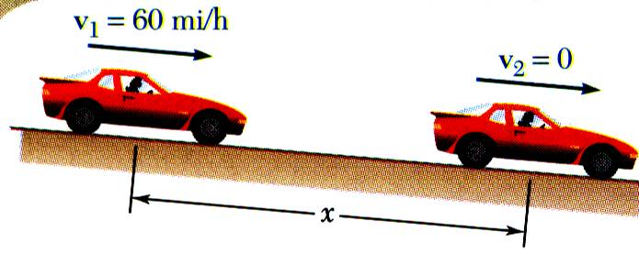
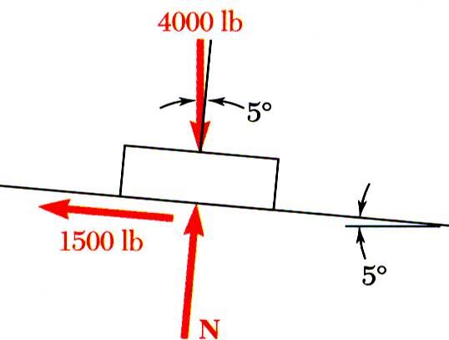
SOLUTION:
Evaluate the change in kinetic energy.
4000 N
Determine the distance required for the work to equal the kinetic energy change.
1500 N

Slide 15
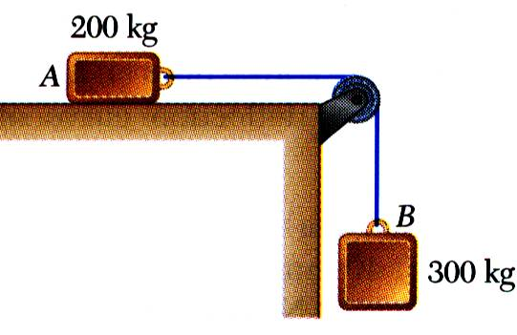
Problem#2
Two blocks are joined by an inextensible cable as shown. If the system is released from rest, determine the velocity of block A after it has moved 2 m. Assume that the coefficient of friction between block A and the plane is μ_{k} = 0.25 and that the pulley is weightless and frictionless.
SOLUTION:
Apply the principle of work and energy separately to blocks A and B.
When the two relations are combined, the work of the cable forces cancel. Solve for the velocity.

Slide 16
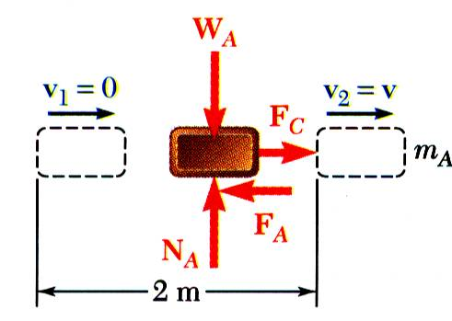
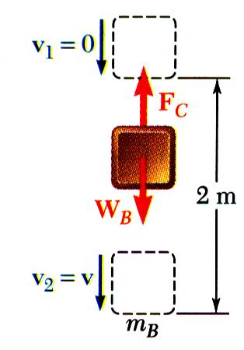
Problem#2
SOLUTION:
Apply the principle of work and energy separately to blocks A and B.

Slide 17
Problem#2
When the two relations are combined, the work of the cable forces cancel. Solve for the velocity.

Slide 18
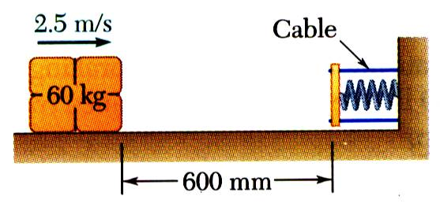
Problem#3
A spring is used to stop a 60 kg package which is sliding on a horizontal surface. The spring has a constant k = 20 kN/m and is held by cables so that it is initially compressed 120 mm. The package has a velocity of 2.5 m/s in the position shown and the maximum deflection of the spring is 40 mm.
Determine (a) the coefficient of kinetic friction between the package and surface and (b) the velocity of the package as it passes again through the position shown.
SOLUTION:
Apply the principle of work and energy between the initial position and the point at which the spring is fully compressed and the velocity is zero. The only unknown in the relation is the friction coefficient.
Apply the principle of work and energy for the rebound of the package. The only unknown in the relation is the velocity at the final position.

Slide 19
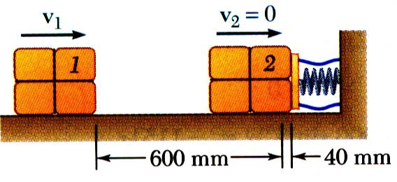
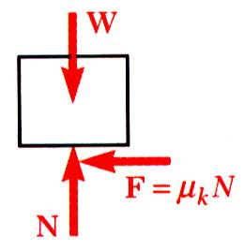
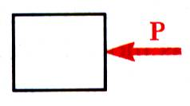
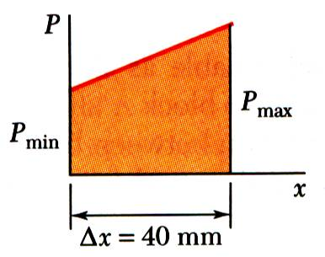
Problem#3
SOLUTION:
Apply principle of work and energy between initial position and the point at which spring is fully compressed.

Slide 20
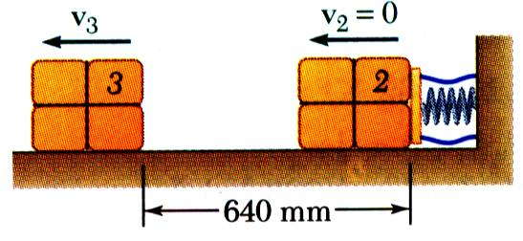
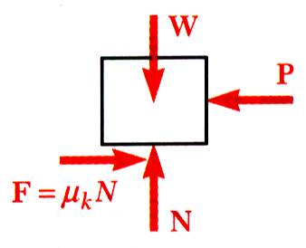
Problem#3
Apply the principle of work and energy for the rebound of the package.

Slide 21
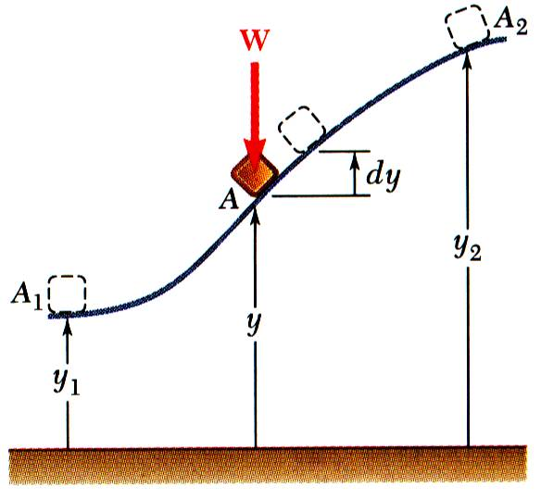
Potential Energy
Work of the force of gravity ,
Work is independent of path followed; depends only on the initial and final values of Wy.
potential energy of the body with respect to force of gravity.
Choice of datum from which the elevation y is measured is arbitrary.
Units of work and potential energy are the same:

Slide 22
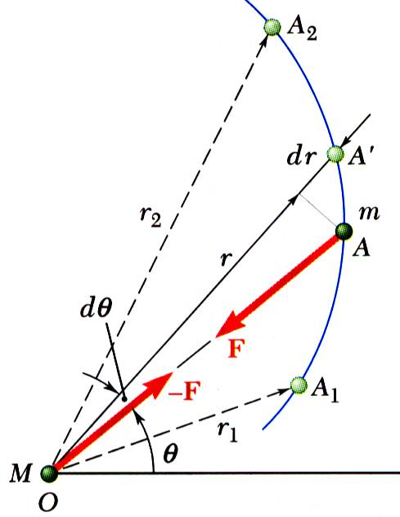
Potential Energy
Previous expression for potential energy of a body with respect to gravity is only valid when the weight of the body can be assumed constant.
For a space vehicle, the variation of the force of gravity with distance from the center of the earth should be considered.
Work of a gravitational force,
Potential energy V_{g} when the variation in the force of gravity can not be neglected,

Slide 23
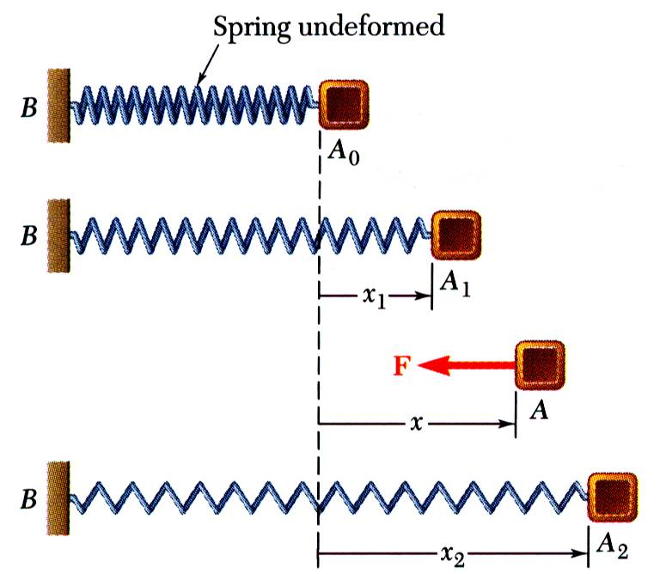
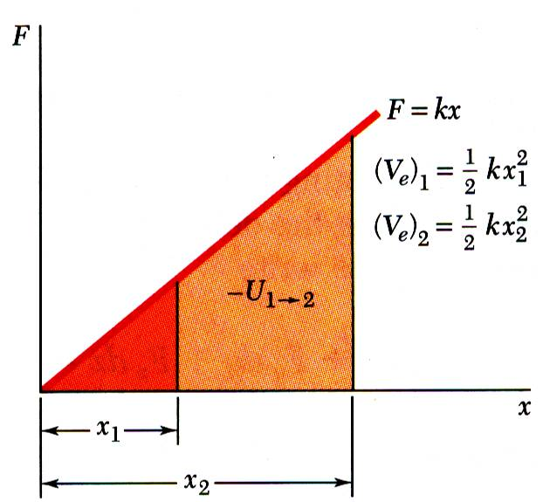
Potential Energy
Work of the force exerted by a spring depends only on the initial and final deflections of the spring,
The potential energy of the body with respect to the elastic force,
Note that the preceding expression for V_{e} is valid only if the deflection of the spring is measured from its undeformed position.

Slide 24
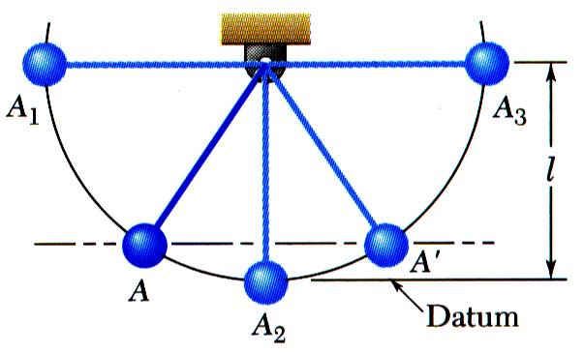

Conservation of Energy
Work of a conservative force,
Concept of work and energy,
$$V_{1}−V_{2}=T_{2}−T_{1}$$
Follows that
When a particle moves under the action of conservative forces, the total mechanical energy is constant.
Friction forces are not conservative. Total mechanical energy of a system involving friction decreases.
Mechanical energy is dissipated by friction into thermal energy. Total energy is constant.

Slide 25
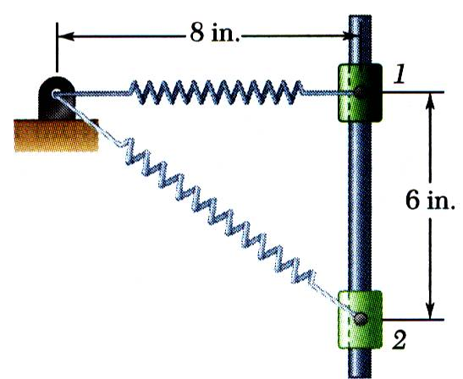
Problem#4
20 cm
A 20 N collar slides without friction along a vertical rod as shown. The spring attached to the collar has an undeflected length of 10 cm. and a constant of 3 N/cm.
If the collar is released from rest at position 1, determine its velocity after it has moved 15 cm. to position 2.
15 cm
SOLUTION:
Apply the principle of conservation of energy between positions 1 and 2.
The elastic and gravitational potential energies at 1 and 2 are evaluated from the given information. The initial kinetic energy is zero.
Solve for the kinetic energy and velocity at 2.

Slide 26
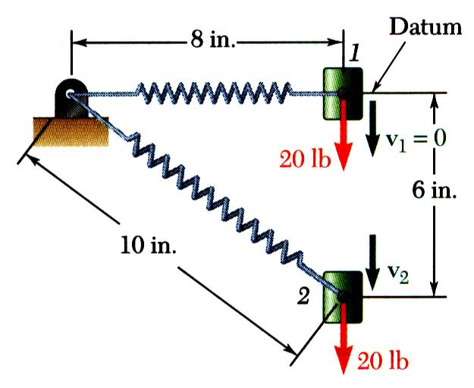
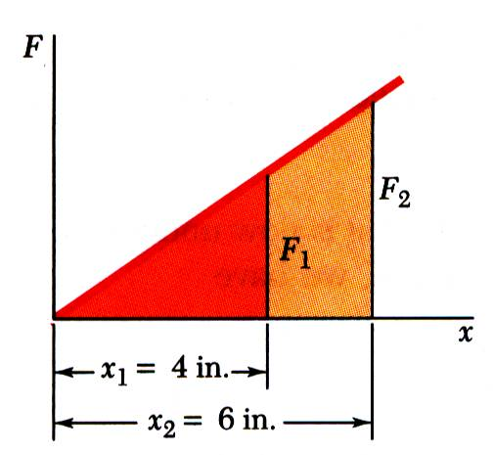
Problem#4
SOLUTION:
Apply the principle of conservation of energy between positions 1 and 2.
20 cm
20 N
15 cm
Position 1:
25 cm
20 N
Position 2:
x1=10 cm
x2=15 cm

Slide 27
Problem#4
Conservation of Energy:

Slide 28
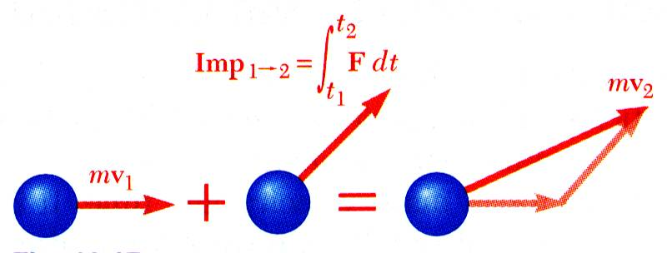
Principle of Impulse and Momentum
From Newton’s second law,
linear momentum
Dimensions of the impulse of a force are force*time.
Units for the impulse of a force are
The final momentum of the particle can be obtained by adding vectorially its initial momentum and the impulse of the force during the time interval.

Slide 29
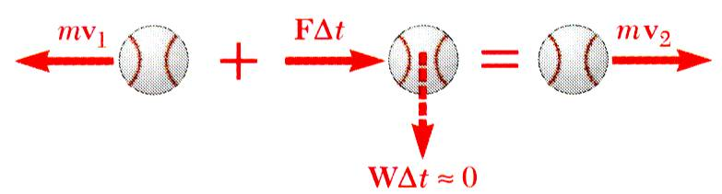
Impulsive Motion
Force acting on a particle during a very short time interval that is large enough to cause a significant change in momentum is called an impulsive force.
When impulsive forces act on a particle,
When a baseball is struck by a bat, contact occurs over a short time interval but force is large enough to change sense of ball motion.
Nonimpulsive forces are forces for which is small and therefore, may be neglected.

Slide 30
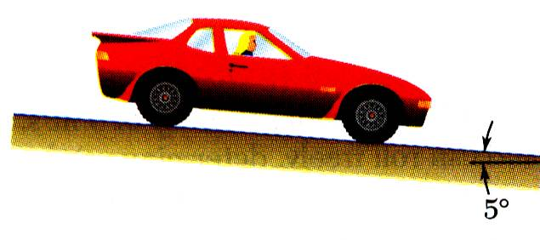
Problem#6
An automobile weighing 4000 N is driven down a 5º incline at a speed of 60 km/h when the brakes are applied, causing a constant total braking force of 1500 N.
Determine the time required for the automobile to come to a stop.
SOLUTION:
Apply the principle of impulse and momentum. The impulse is equal to the product of the constant forces and the time interval.

Slide 31
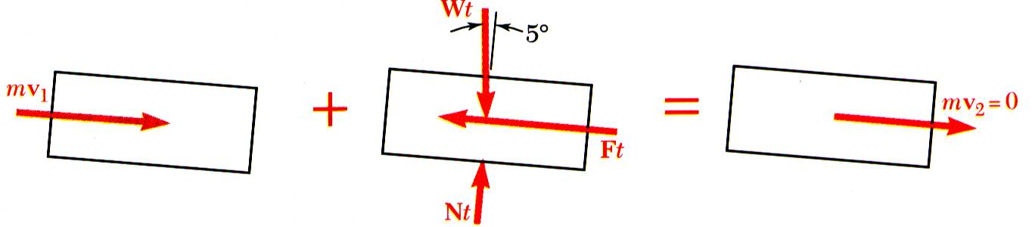
SOLUTION:
Apply the principle of impulse and momentum.
Taking components parallel to the incline,

Slide 32
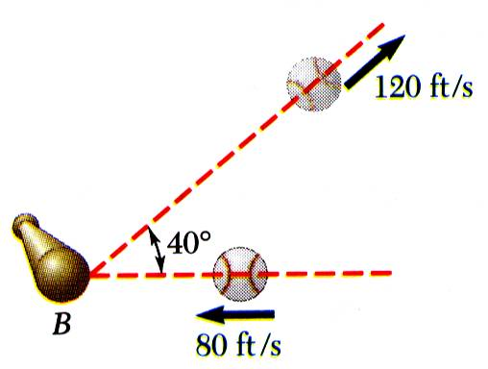
Problem#7
A 100 gm baseball is pitched with a velocity of 80 m/s. After the ball is hit by the bat, it has a velocity of 120 m/s in the direction shown. If the bat and ball are in contact for 0.015 s, determine the average impulsive force exerted on the ball during the impact.
120 m/s
80 m/s
SOLUTION:
Apply the principle of impulse and momentum in terms of horizontal and vertical component equations.

Slide 33
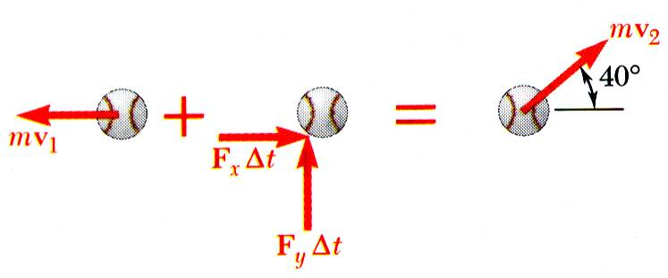
Problem#7
SOLUTION:
Apply the principle of impulse and momentum in terms of horizontal and vertical component equations.
120 m/s
x component equation:
80 m/s
y component equation:

Slide 34
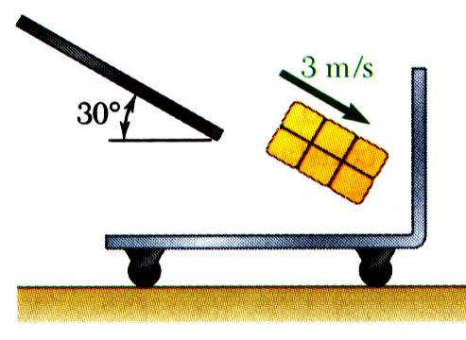
Problem#8
A 10 kg package drops from a chute into a 25 kg cart with a velocity of 3 m/s. Knowing that the cart is initially at rest and can roll freely, determine (a) the final velocity of the cart, (b) the impulse exerted by the cart on the package, and (c) the fraction of the initial energy lost in the impact.
SOLUTION:
Apply the principle of impulse and momentum to the package-cart system to determine the final velocity.
Apply the same principle to the package alone to determine the impulse exerted on it from the change in its momentum.

Slide 35
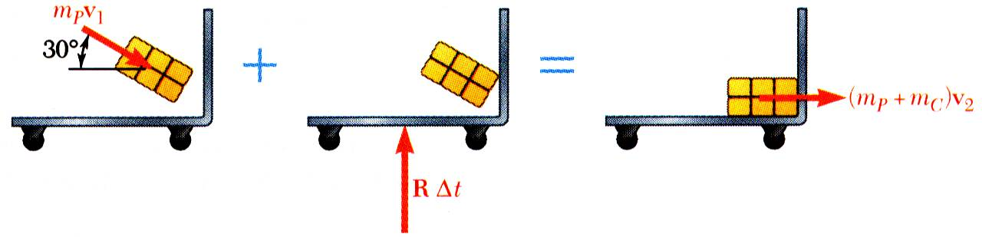

Problem#8
SOLUTION:
Apply the principle of conservation of momentum to the package-cart system to determine the final velocity.
$$\vec{Vc}=0$$
x components:

Slide 36
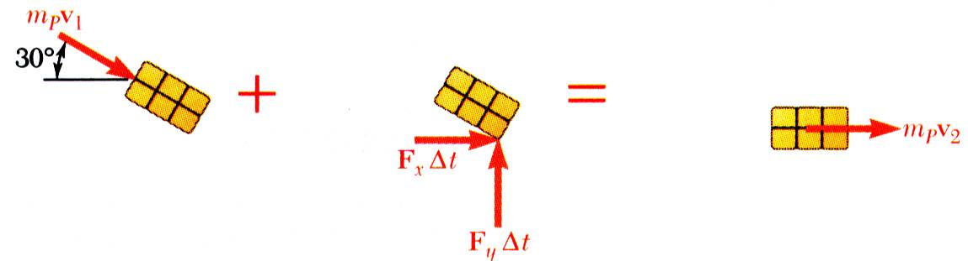
Problem#8
Apply the same principle to the package alone to determine the impulse exerted on it from the change in its momentum.
y
x
x components:
y components:

Slide 37
Problem#8
To determine the fraction of energy lost,

Slide 38
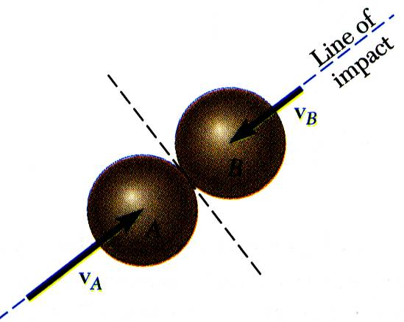
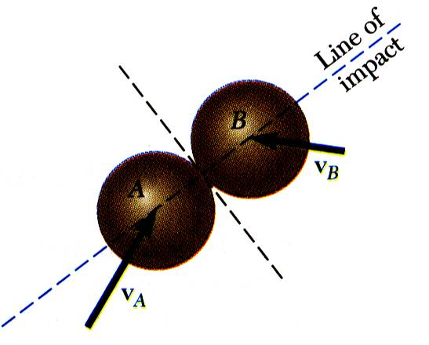
Impact
Impact: Collision between two bodies which occurs during a small time interval and during which the bodies exert large forces on each other.
Line of Impact: Common normal to the surfaces in contact during impact.
Central Impact: Impact for which the mass centers of the two bodies lie on the line of impact; otherwise, it is an eccentric impact..
Direct Central Impact
Direct Impact: Impact for which the velocities of the two bodies are directed along the line of impact.
Oblique Impact: Impact for which one or both of the bodies move along a line other than the line of impact.
Oblique Central Impact

Slide 39
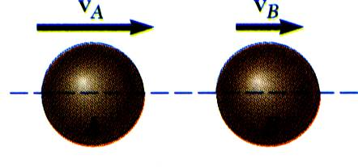
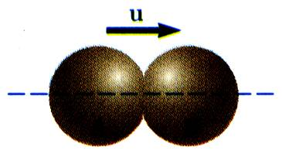
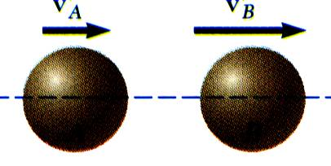
Direct Central Impact
Bodies moving in the same straight line, v_{A} > v_{B} .
Upon impact the bodies undergo a period of deformation, at the end of which, they are in contact and moving at a common velocity.
A period of restitution follows during which the bodies either regain their original shape or remain permanently deformed.
Wish to determine the final velocities of the two bodies. The total momentum of the two body system is preserved,
A second relation between the final velocities is required.

Slide 40
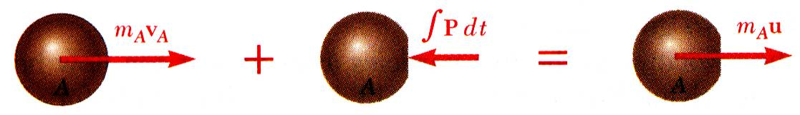
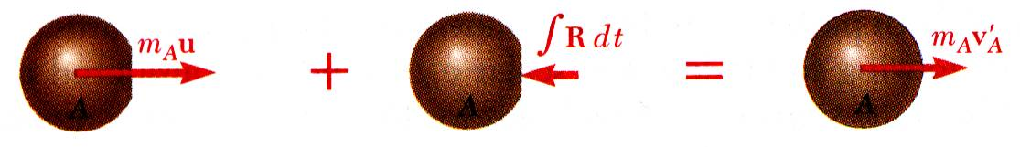
Direct Central Impact
Period of deformation:
Period of restitution:
A similar analysis of particle B yields
Combining the relations leads to the desired second relation between the final velocities.
Perfectly plastic impact, e = 0:
Perfectly elastic impact, e = 1: Total energy and total momentum conserved.

Slide 41
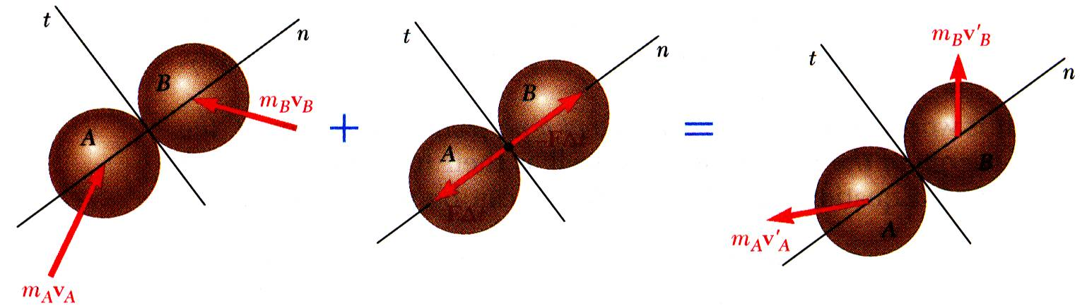
Oblique Central Impact
Final velocities are unknown in magnitude and direction. Four equations are required.
No tangential impulse component; tangential component of momentum for each particle is conserved.
Normal component of total momentum of the two particles is conserved.
Normal components of relative velocities before and after impact are related by the coefficient of restitution.

Slide 42

Problems Involving Energy and Momentum
Three methods for the analysis of kinetics problems:
Direct application of Newton’s second law
Method of work and energy
Method of impulse and momentum
Select the method best suited for the problem or part of a problem under consideration.

Slide 43

Problem#9
A ball is thrown against a frictionless, vertical wall. Immediately before the ball strikes the wall, its velocity has a magnitude v and forms angle of 30º with the horizontal. Knowing that e = 0.90, determine the magnitude and direction of the velocity of the ball as it rebounds from the wall.
SOLUTION:
Resolve ball velocity into components normal and tangential to wall.
Impulse exerted by the wall is normal to the wall. Component of ball momentum tangential to wall is conserved.
Assume that the wall has infinite mass so that wall velocity before and after impact is zero. Apply coefficient of restitution relation to find change in normal relative velocity between wall and ball, i.e., the normal ball velocity.

Slide 44

Problem#9
SOLUTION:
Resolve ball velocity into components parallel and perpendicular to wall.
Component of ball momentum tangential to wall is conserved.
t
Apply coefficient of restitution relation with zero wall velocity.
n

Slide 45

Problem#10
A 30 kg block is dropped from a height of 2 m onto the 10 kg pan of a spring scale. Assuming the impact to be perfectly plastic, determine the maximum deflection of the pan. The constant of the spring is k = 20 kN/m.
SOLUTION:
Apply the principle of conservation of energy to determine the velocity of the block at the instant of impact.
Since the impact is perfectly plastic, the block and pan move together at the same velocity after impact. Determine that velocity from the requirement that the total momentum of the block and pan is conserved.
Apply the principle of conservation of energy to determine the maximum deflection of the spring.

Slide 46


Problem#10
SOLUTION:
Apply principle of conservation of energy to determine velocity of the block at instant of impact.
Determine velocity after impact from requirement that total momentum of the block and pan is conserved.

Slide 47

Problem#10
Apply the principle of conservation of energy to determine the maximum deflection of the spring.
Initial spring deflection due to pan weight:

Slide 48

Angular Momentum
The angular momentum $\vec{H_{0}}$ of a particle about point O is defined as the ”moment” of the particle’s linear momentum about O. It is sometimes referred to as the moment of the momentum.
Scalar Formulation
Consider a particle of mass m moving in the x-y plane with a velocity $\vec{V}$.

Slide 49



Scalar Formulation
The magnitude of the angular momentum of this particle about point O has a magnitude equal to $dm\left|\overline{V}\right|$where d is the moment arm or the perpendicular distance from O to the line of action of $m\overline{V}$ .
The direction can be found using the right hand rule Curling your right hand in the direction of $m\overline{V}$ from the reference O.
The extended thump points in the direction of $\vec{H_{0}}$.
Common units for $\vec{H_{0}}$ are kg · m2/s or slug · ft2/s.
Vector Formulation:
If the particle is moving along a space curve and $\vec{r}$ is a position vector drawn
from point O to the particle P then
$$\vec{H_{0}}=\vec{r}×m\vec{V}$$

Slide 50

Vector Formulation:
As shown in the figure $\vec{H_{0}}$ is perpendicular to the plane made of $\vec{r}$ and $m\vec{V}$.
In the cartesian coordinate system where all vectors are expressed in terms of the unit vector along the x, y and z axes the angular momentum is determined by evaluating the determinant:
$$\left|\begin{matrix}\hat{i} & \hat{j} & \hat{k} \\ r_{x} & r_{y} & r_{z} \\ mV_{x} & mV_{y} & mV_{z}\end{matrix}\right|$$

Slide 51




Angular Momentum
$$H=r×mv$$
$$mv$$
A particle undergoing uniform circular motion at constant angular velocity ω in the (x, y) plane with the origin O at the centre of circle.
We not that
1 Because $H=r×mv$ is perpendicular to both r and mv, it must point along the axis of rotation. Moreover, application of the right hand rule shows that H points in the same direction as ω.
2 Because the angle between r and mv is ${90}^{0}$, the magnitude of the angular momentum vector is $H=mvr$ .

Slide 52




Angular Momentum
$$v=\left|\frac{ds}{dt}\right|=\left|\frac{d(rθ)}{dt}\right|=\left|r\frac{dθ}{dt}\right|=rω$$
By putting value
$$I=mr^{2}$$
$$H=mr^{2}ω$$
So the angular momentum is proportional to the angular speed. Since H and ω have been shown to point in the same direction this result can be expressed in vector form:
$$H=mr^{2}ω=Iω$$
Where the constant of proportionality $I=mr^{2}$ is called moment of inertia of the orbiting particle.

Slide 53

Relation between moment of a force and angular momentum:
F
Consider a particle of constant mass m moving in an inertial frame as shown in the figure. Newton’s second applied to the particle states that
$$\sum{\vec{F}=\frac{d\left(m\vec{V}\right)}{dt}=m\vec{a}}$$

Slide 54

Relation between moment of a force and angular momentum:
The moment of the forces about point O $\sum{\vec{M_{0}}}$ can be expressed using Newton’s second law as
$$\sum{\vec{M_{0}}=\vec{r}×\sum{\vec{F}=\vec{r}×m\dot{\dot{\vec{V}}=\frac{d}{dt}\left(\vec{r}×m\vec{V}\right)=\dot{\vec{H_{0}}}}}}$$
This equation states that the resultant moment about point O of all the forces acting on the particle is equal to the time rate of change of the particle’s angular momentum about point O.

Slide 55



Angular Impulse and Momentum Principles
$\sum{\vec{M_{0}}=\dot{\vec{H_{0}}}}$this equation can be rewritten as follows
$$\sum{\vec{M_{0}}=\dot{\vec{H_{0}}=\frac{d\vec{H_{0}}}{dt}}}$$
Now integrating above equation
$$\int{\sum{\vec{M_{0}}dt=\int{d\vec{H_{0}}}}}$$
we have assuming that at time t = t1,$\vec{H_{0}}={\left(\vec{H_{0}}\right)}_{1}$ and at time t = t2, $\vec{H_{0}}={\left(\vec{H_{0}}\right)}_{2}$
$$\sum{\int_{t1}^{t2}{\vec{M_{0}}dt={\left(\vec{H_{0}}\right)}_{2}−{\left(\vec{H_{0}}\right)}_{1}}}$$
This equation is referred to as the principle of angular impulse and momentum.

Slide 56

Angular Impulse and Momentum Principles
The initial and final angular momentum $\vec{H_{0}}={\left(\vec{H_{0}}\right)}_{1}$and $\vec{H_{0}}={\left(\vec{H_{0}}\right)}_{2}$ are defined as the moment of linear momentum of the particle at the instant t1 and t2 respectively.
The second term on the left side $\sum{\int_{t1}^{t2}{\vec{M_{0}}dt}}$ is called the angular impulse.
It is determined by integrating with respect to time, the moments of all the forces acting on the particle over the time period t1 to t2
$$angular impluse=\sum{\int_{t1}^{t2}{\vec{M_{0}}dt}}=\int_{t1}^{t2}{\left(\vec{r}×\vec{F}\right)dt}$$

Slide 57

Conservation of Angular Momentum:
When the angular impulses acting on a particle are all zero during the time t1 to t2 we have
$${\left(\vec{H_{0}}\right)}_{1}={\left(\vec{H_{0}}\right)}_{2}$$
which is known as conservation of angular momentum.
If no external impulse is applied to the particle, both linear and angular momentum will be conserved.
Conservation of angular momentum for a system of particles is given by
$$\sum{{\left(\vec{H_{0}}\right)}_{1}}=\sum{{\left(\vec{H_{0}}\right)}_{2}}$$

Slide 58

Work of Forces Acting on a Rigid Body

Slide 59


Kinetic Energy of a Rigid Body
Consider a rigid body rotating about a fixed axis through O.
Consider a rigid body of mass m in plane motion.

Slide 60

Problem#11
An ice skater starts her spin with arms outstretched, rotating at 1.5 rev/s. Estimate her rotational speed (in rev/s) when she brings her arms back against her body.
• Ice skater body is a cylinder ( r ≈ 0.2 m, Mb ≈ 50 kg).
• Each arm is a thin rod ( ℓ ≈ 1 m, Ma ≈ 5 kg, rh ≈ 0.01 m).

Slide 61


Problem#11
This is a conservation of angular momentum problem
$$I_{1}ω_{1}=I_{2}ω_{2}$$

Slide 62
Problem#12
For the drum and flywheel, I = 10.5 lb⋅ ft ⋅s2. The bearing friction is equivalent to a couple of 60 lb⋅ ft.
At the instant shown, the block is moving downward at 6 ft/s.
Determine the velocity of the block after it
has moved 4 ft downward.
SOLUTION:
Consider the system of the flywheel and block. The work done by the internal forces exerted by the cable cancels.
Note that the velocity of the block and the angular velocity of the drum and flywheel are related by v = rω
Apply the principle of work and kinetic energy to develop an expression for the final velocity.

Slide 63

Problem#11

Slide 64

Problem#11

Slide 65

Problem#12
The system is at rest when a moment of M = 6 N⋅m is applied to gear B.
Neglecting friction, a) determine the number of revolutions of gear B before its angular velocity reaches 600 rpm, and b) tangential force exerted by gear B on gear A.
SOLUTION:
Consider a system consisting of the two gears. Noting that the gear rotational speeds are related, evaluate the final kinetic energy of the system.
Apply the principle of work and energy. Calculate the number of revolutions required for the work of the applied moment to equal the final kinetic energy of the system.
Apply the principle of work and energy to a system consisting of gear A. With the
final kinetic energy and number of revolutions known, calculate the moment and tangential force required for the indicated work.

Slide 66


Problem#12
$$ω=\frac{2πN}{60}$$

Slide 67

Problem#12

Slide 68


Motion Under a Conservative Central Force
When a particle moves under a conservative central force, both the principle of conservation of angular momentum and the principle of conservation of energy may be applied.
Given r, the equations may be solved for v and ϕ.
At minimum and maximum r, ϕ = 90º. Given the launch conditions, the equations may be solved for r_{min}, r_{max}, v_{min}, and v_{max}.

Slide 69

Problem#
A satellite is launched in a direction parallel to the surface of the earth with a velocity of 36900 km/h from an altitude of 500 km.
Determine (a) the maximum altitude reached by the satellite, and (b) the maximum allowable error in the direction of launching if the satellite is to come no closer than 200 km to the surface of the earth
SOLUTION:
For motion under a conservative central force, the principles of conservation of energy and conservation of angular momentum may be applied simultaneously.
Apply the principles to the points of minimum and maximum altitude to determine the maximum altitude.
Apply the principles to the orbit insertion point and the point of minimum altitude to determine maximum allowable orbit insertion angle error.

Slide 70

SOLUTION
Apply the principles of conservation of energy and conservation of angular momentum to the points of minimum and maximum altitude to determine the maximum altitude.
Conservation of energy:
Conservation of angular momentum:
Combining,

Slide 71

SOLUTION
Apply the principles to the orbit insertion point and the point of minimum altitude to determine maximum allowable orbit insertion angle error.
Conservation of energy:
Conservation of angular momentum:
Combining and solving for sin ϕ₀,

